Slide 1

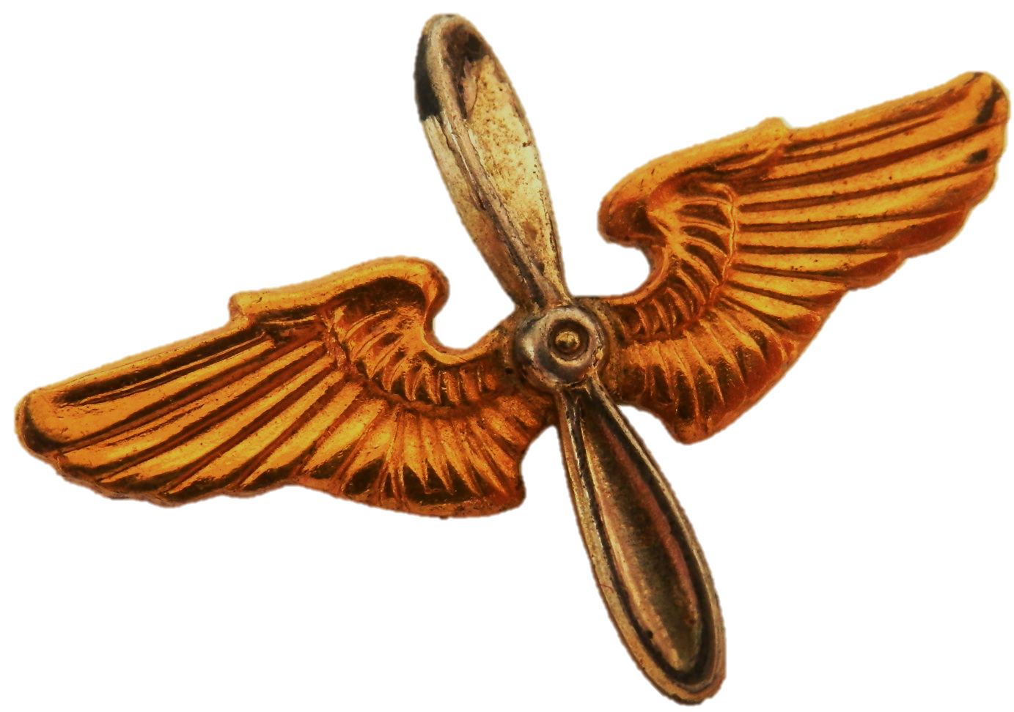
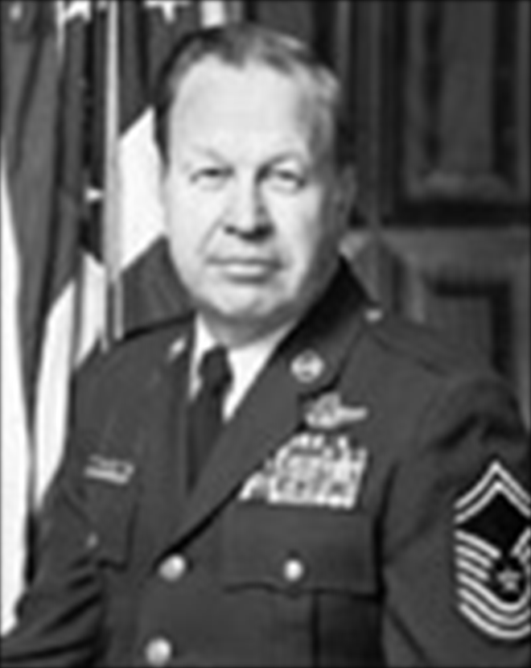
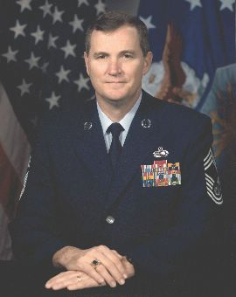
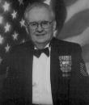
Enlisted
Communicators in History
CMSgt Charles E. Teston
During Chief Teston’s career, he flew more than 100 combat support missions, was an academic instructor, first sergeant, a Senior Enlisted Advisor, and superintendent of radio operations. After he retired, he was inducted into the Air Force Communications and Information Hall of Fame.
To change pictures:
Save the picture of the person you wish to use.
Single-left-click the grouped picture/shapes you wish to change on the poster. Single-left-click again on the picture.
Now single-right-click the picture and select “Change Picture” from the menu.
Choose the picture file you saved.
You may wish to single-left-click the grouped picture/shapes and single-left-click the new picture again to adjust its size or crop it—especially useful if the new picture is not the same aspect ratio as the previous one.
DO NOT CHANGE PROP AND WINGS PICTURE!!!
CMSgt Eric W. Benken
Chief Benken entered the Air Force with a background in information management and served as an administrative specialist. During his career, he served as Senior Enlisted Adviser with the USAF in Europe and he became the Chief Master Sergeant of the Air Force in 1996.
MSgt Joseph J. Duffy
MSgt Duffy served 42 years as a leader in Communications Security. He served two tours in Vietnam, managed the largest COMSEC account in the world, and earned the Bronze Star. He was also inducted into the Air Force Communications and Information Hall of Fame in 2010.
How will you leave your mark on the cyber operations domain?

